Slide 1

Design and Analysis of Algorithms
Part I: Divide and Conquer
Lecture 3: Maximum Contiguous Subarray Problem
and Counting Inversion Problem
Ke Xu and Yongxin Tong
(许可 与 童咏昕)
School of CSE, Beihang University

Slide 2
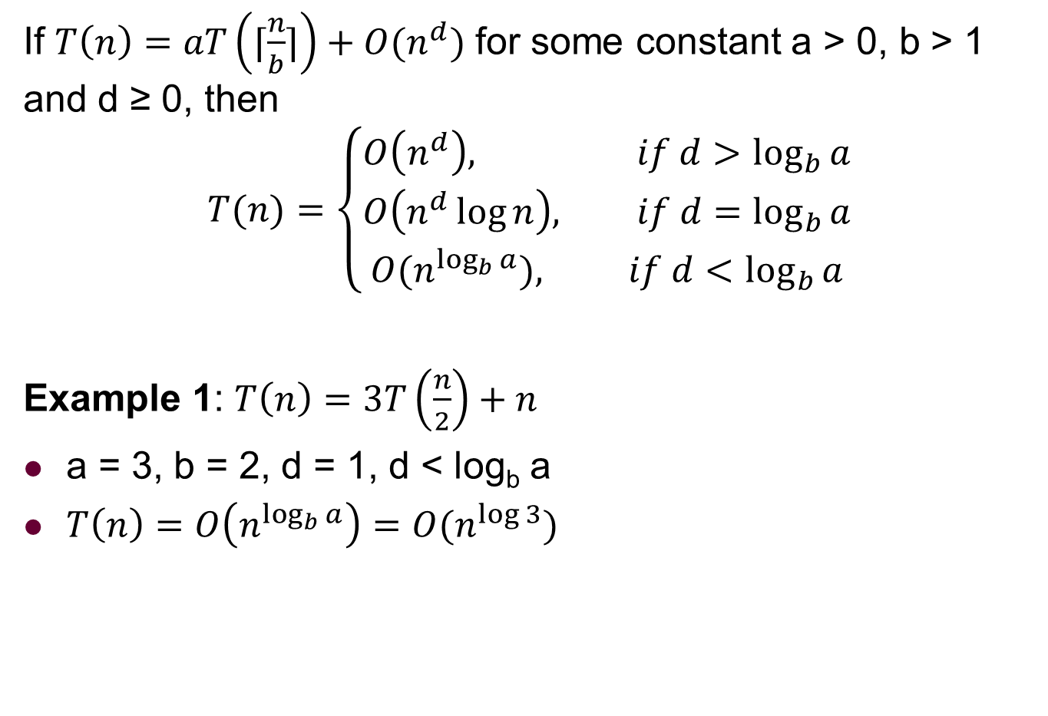
Master theorem: Review
If $T\left(n\right)=aT\left(⌈\frac{n}{b}⌉\right)+O(n^{d})$ for some constant a > 0, b > 1 and d ≥ 0, then
$$T(n)=\left\{\begin{aligned}O\left(n^{d}\right), if d>\log_{b}{a} \\ O\left(n^{d}\log{n}\right), if d=\log_{b}{a} \\ &O(n^{\log_{b}{a}}), if d<\log_{b}{a}\end{aligned}\right.$$
Example 1: $T\left(n\right)=3T\left(\frac{n}{2}\right)+n$
a = 3, b = 2, d = 1, d < log_{b} a
$T\left(n\right)=O\left(n^{\log_{b}{a}}\right)=O(n^{\log{3}})$

Slide 3

Master theorem: Review
If $T\left(n\right)=aT\left(⌈\frac{n}{b}⌉\right)+O(n^{d})$ for some constant a > 0, b > 1 and d ≥ 0, then
$$T(n)=\left\{\begin{aligned}O\left(n^{d}\right), if d>\log_{b}{a} \\ O\left(n^{d}\log{n}\right), if d=\log_{b}{a} \\ &O(n^{\log_{b}{a}}), if d<\log_{b}{a}\end{aligned}\right.$$
Example 2: $T\left(n\right)=3T\left(\frac{n}{4}\right)+n^{5}$
a = 3, b = 4, d = 5, d > log_{b} a
$T\left(n\right)=O\left(n^{d}\right)=O(n^{5})$

Slide 4

Master theorem: Review
If $T\left(n\right)=aT\left(⌈\frac{n}{b}⌉\right)+O(n^{d})$ for some constant a > 0, b > 1 and d ≥ 0, then
$$T(n)=\left\{\begin{aligned}O\left(n^{d}\right), if d>\log_{b}{a} \\ O\left(n^{d}\log{n}\right), if d=\log_{b}{a} \\ &O(n^{\log_{b}{a}}), if d<\log_{b}{a}\end{aligned}\right.$$
Example 3: $T\left(n\right)=4T\left(\frac{n}{2}\right)+n^{2}$
a = 4, b = 2, d = 2, d = log_{b} a
$T\left(n\right)=O\left(n^{d}\log{n}\right)=O(n^{2}\log{n})$

Slide 5
Outline
Introduction to Part I
Maximum Contiguous Subarray Problem
Problem definition
A brute force algorithm
A data-reuse algorithm
A divide-and-conquer algorithm
Analysis of the divide-and-conquer algorithm
Counting Inversions Problem
Problem definition
A brute force algorithm
A divide-and-conquer algorithm
Analysis of the divide-and-conquer algorithm

Slide 6
Outline
Introduction to Part I
Maximum Contiguous Subarray Problem
Problem definition
A brute force algorithm
A data-reuse algorithm
A divide-and-conquer algorithm
Analysis of the divide-and-conquer algorithm
Counting Inversions Problem
Problem definition
A brute force algorithm
A divide-and-conquer algorithm
Analysis of the divide-and-conquer algorithm

Slide 7
Introduction to Part I
Divide-and-conquer (D&C) is an important algorithm design paradigm.

Slide 8
Introduction to Part I
Divide-and-conquer (D&C) is an important algorithm design paradigm.
Divide Dividing a given problem into two or more subproblems (ideally of approximately equal size)

Slide 9
Introduction to Part I
Divide-and-conquer (D&C) is an important algorithm design paradigm.
Divide Dividing a given problem into two or more subproblems (ideally of approximately equal size)
Conquer Solving each subproblem (directly if small enough or recursively)

Slide 10
Introduction to Part I
Divide-and-conquer (D&C) is an important algorithm design paradigm.
Divide Dividing a given problem into two or more subproblems (ideally of approximately equal size)
Conquer Solving each subproblem (directly if small enough or recursively)
Combine Combining the solutions of the subproblems into a global solution

Slide 11
Introduction to Part I
In Part I, we will illustrate Divide-and-Conquer using several examples:
Maximum Contiguous Subarray (最大子数组)
Counting Inversions (逆序计数)
Polynomial Multiplication (多项式乘法)
QuickSort and Partition (快速排序与划分)
Lower Bound for Sorting (基于比较的排序下界)

Slide 12
Outline
Introduction to Part I
Maximum Contiguous Subarray Problem
Problem definition
A brute force algorithm
A data-reuse algorithm
A divide-and-conquer algorithm
Analysis of the divide-and-conquer algorithm
Counting Inversions Problem
Problem definition
A brute force algorithm
A divide-and-conquer algorithm
Analysis of the divide-and-conquer algorithm

Slide 13
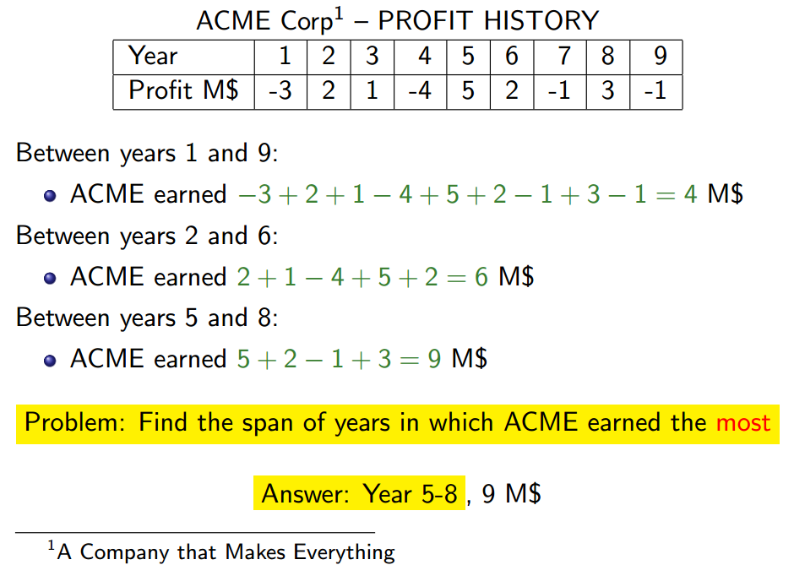
Maximum Contiguous Subarray (MCS) Problem

Slide 14
Maximum Contiguous Subarray (MCS) Problem

Slide 15
Maximum Contiguous Subarray (MCS) Problem

Slide 16
Maximum Contiguous Subarray (MCS) Problem

Slide 17
Maximum Contiguous Subarray (MCS) Problem

Slide 18
Maximum Contiguous Subarray (MCS) Problem
如果所有数组元素都是非负数，整个数组和肯定是最大

Slide 19
Formal Definition
Input: An array of reals A[1…n]

Slide 20
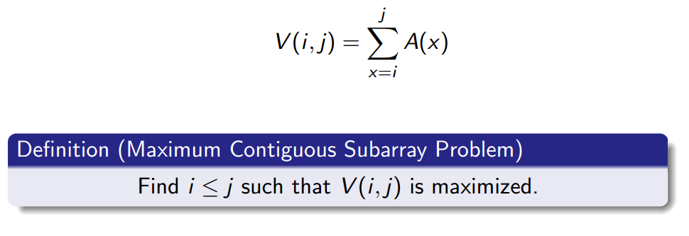
Formal Definition
Input: An array of reals A[1…n]
The value of subarray A[i…j] is

Slide 21
Formal Definition
Input: An array of reals A[1…n]
The value of subarray A[i…j] is

Slide 22
Outline
Introduction to Part I
Maximum Contiguous Subarray Problem
Problem definition
A brute force algorithm
A data-reuse algorithm
A divide-and-conquer algorithm
Analysis of the divide-and-conquer algorithm
Counting Inversions Problem
Problem definition
A brute force algorithm
A divide-and-conquer algorithm
Analysis of the divide-and-conquer algorithm

Slide 23
A Brute Force Algorithm

Slide 24
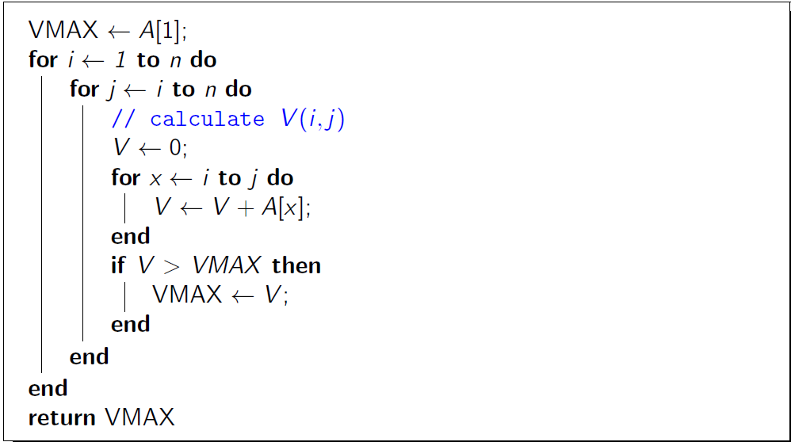
A Brute Force Algorithm

Slide 25
A Brute Force Algorithm

Slide 26
A Brute Force Algorithm

Slide 27

A Brute Force Algorithm

Slide 28
Outline
Introduction to Part I
Maximum Contiguous Subarray Problem
Problem definition
A brute force algorithm
A data-reuse algorithm
A divide-and-conquer algorithm
Analysis of the divide-and-conquer algorithm
Counting Inversions Problem
Problem definition
A brute force algorithm
A divide-and-conquer algorithm
Analysis of the divide-and-conquer algorithm

Slide 29
A Data-Reuse Algorithm
Idea:
don’t need to calculate each V(i, j) from scratch

Slide 30
A Data-Reuse Algorithm
Idea:
don’t need to calculate each V(i, j) from scratch
exploit the fact:

Slide 31
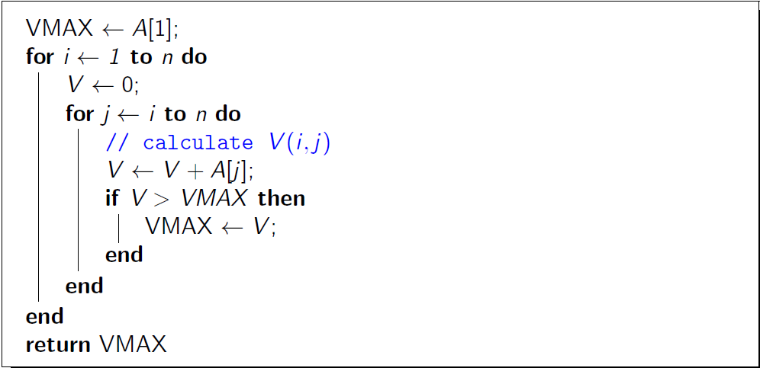
A Data-Reuse Algorithm
Idea:
don’t need to calculate each V(i, j) from scratch
exploit the fact:

Slide 32
A Data-Reuse Algorithm
Idea:
don’t need to calculate each V(i, j) from scratch
exploit the fact:

Slide 33

A Data-Reuse Algorithm
Idea:
don’t need to calculate each V(i, j) from scratch
exploit the fact:

Slide 34
Outline
Introduction to Part I
Maximum Contiguous Subarray Problem
Problem definition
A brute force algorithm
A data-reuse algorithm
A divide-and-conquer algorithm
Analysis of the divide-and-conquer algorithm
Counting Inversions Problem
Problem definition
A brute force algorithm
A divide-and-conquer algorithm
Analysis of the divide-and-conquer algorithm

Slide 35
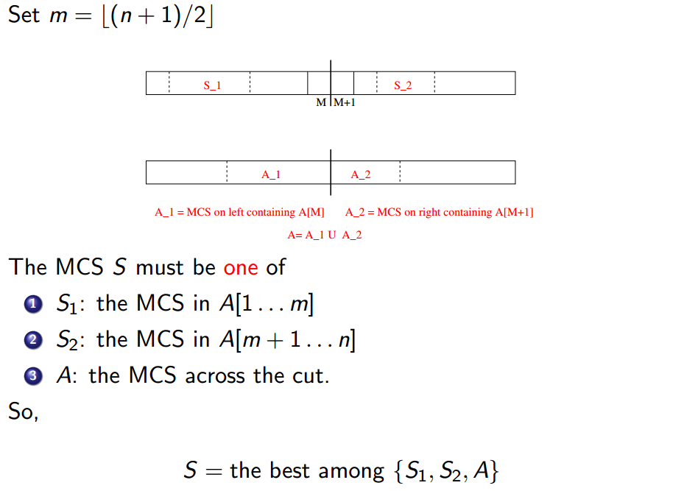
A Divide-and-Conquer Algorithm

Slide 36
A Divide-and-Conquer Algorithm

Slide 37
A Divide-and-Conquer Algorithm

Slide 38
A Divide-and-Conquer Algorithm

Slide 39
A Divide-and-Conquer Algorithm

Slide 40
A Divide-and-Conquer Algorithm
最终，在S₁,S₂和A(跨越中点的最大子数组)这三种情况中选取和最大者

Slide 41
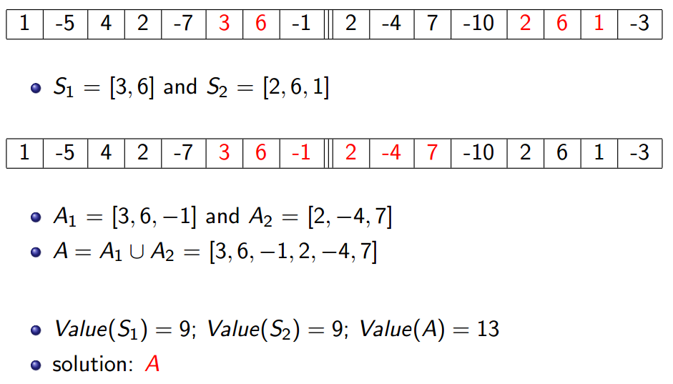
An Example of Divide-and-Conquer Algorithm

Slide 42
An Example of Divide-and-Conquer Algorithm

Slide 43
An Example of Divide-and-Conquer Algorithm

Slide 44
An Example of Divide-and-Conquer Algorithm

Slide 45
An Example of Divide-and-Conquer Algorithm

Slide 46
An Example of Divide-and-Conquer Algorithm

Slide 47
An Example of Divide-and-Conquer Algorithm

Slide 48
An Example of Divide-and-Conquer Algorithm

Slide 49
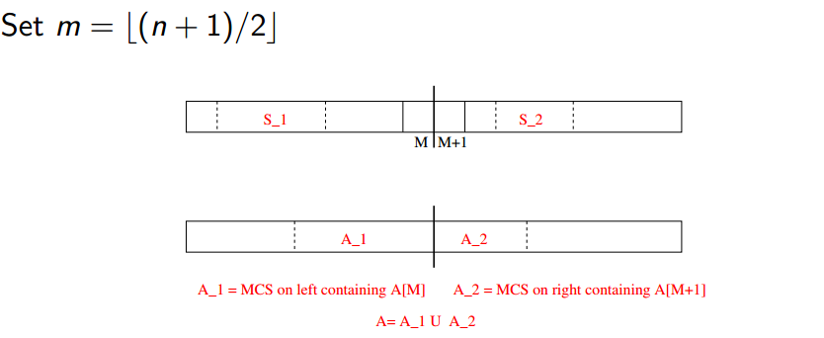
Divide: MCS across The Cut
Problem definition

Slide 50
Divide: MCS across The Cut
Problem definition
A = A₁∪A₂
A₁: MCS among contiguous subarrays ending at A[m]

Slide 51
Divide: MCS across The Cut
Problem definition
A = A₁∪A₂
A₁: MCS among contiguous subarrays ending at A[m]
A₂: MCS among contiguous subarrays starting at A[m+1]

Slide 52
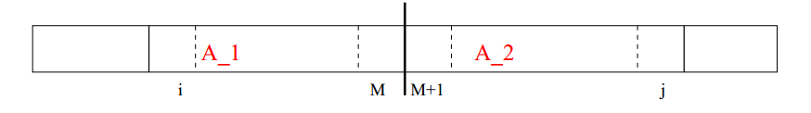
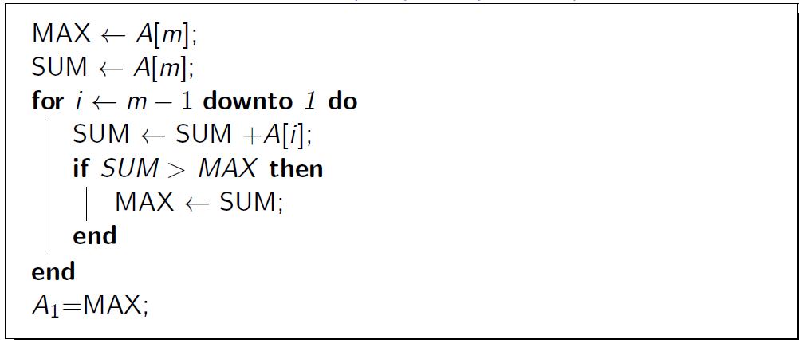
Conquer: Finding the "A₁” Subarrays

Slide 53
Conquer: Finding the "A₁” Subarrays

Slide 54
Conquer: Finding the "A₁” Subarrays

Slide 55
Conquer: Finding the "A₁” Subarrays

Slide 56
Conquer: Finding "A” with A Linear Time
There are only m sequences of the form

Slide 57
Conquer: Finding "A” with A Linear Time
There are only m sequences of the form
A₁ can be found in O(m) time

Slide 58
Conquer: Finding "A” with A Linear Time
There are only m sequences of the form
A₁ can be found in O(m) time
Similarly, A₂ is in the form A[m+1…j]

Slide 59
Conquer: Finding "A” with A Linear Time
There are only m sequences of the form
A₁ can be found in O(m) time
Similarly, A₂ is in the form A[m+1…j]
there are only n−m such sequences

Slide 60
Conquer: Finding "A” with A Linear Time
There are only m sequences of the form
A₁ can be found in O(m) time
Similarly, A₂ is in the form A[m+1…j]
there are only n−m such sequences
A₂ can be found in O(n−m) time

Slide 61
Conquer: Finding "A” with A Linear Time
There are only m sequences of the form
A₁ can be found in O(m) time
Similarly, A₂ is in the form A[m+1…j]
there are only n−m such sequences
A₂ can be found in O(n−m) time
A = A₁∪A₂ can be found in O(n) time

Slide 62
Conquer: Finding "A” with A Linear Time
There are only m sequences of the form
A₁ can be found in O(m) time
Similarly, A₂ is in the form A[m+1…j]
there are only n−m such sequences
A₂ can be found in O(n−m) time
A = A₁∪A₂ can be found in O(n) time
linear to the input size

Slide 63

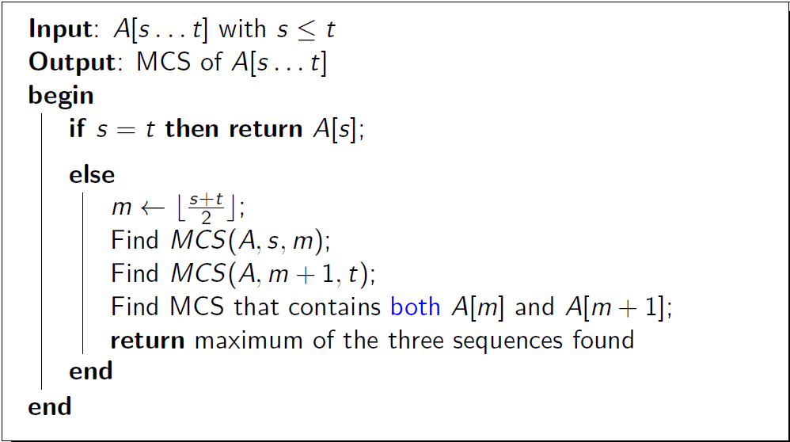
The Complete Divide-and-Conquer Algorithm

Slide 64
The Complete Divide-and-Conquer Algorithm

Slide 65
The Complete Divide-and-Conquer Algorithm

Slide 66
The Complete Divide-and-Conquer Algorithm

Slide 67
The Complete Divide-and-Conquer Algorithm

Slide 68
The Complete Divide-and-Conquer Algorithm

Slide 69
The Complete Divide-and-Conquer Algorithm

Slide 70
The Complete Divide-and-Conquer Algorithm
First Call: MCS(A, 1, n)

Slide 71
A Full Illustration of the D&C Algorithm
6
-4
7
-4
0
1

Slide 72
A Full Illustration of the D&C Algorithm
6
-4
7
-4
0
1

Slide 73
A Full Illustration of the D&C Algorithm
6
-4
7
-4
0
1
6
-4
7
-4
0
1

Slide 74
A Full Illustration of the D&C Algorithm
6
-4
7
-4
0
1
6
-4
7
-4
0
1

Slide 75
A Full Illustration of the D&C Algorithm
6
-4
7
-4
0
1
6
-4
7
-4
0
1
6
-4
-4
0

Slide 76
A Full Illustration of the D&C Algorithm
6
-4
7
-4
0
1
6
-4
7
-4
0
1
6
-4
-4
0

Slide 77
A Full Illustration of the D&C Algorithm
6
-4
7
-4
0
1
6
-4
7
-4
0
1
6
-4
-4
0
Divide

Slide 78
A Full Illustration of the D&C Algorithm
6
-4
7
-4
0
1
6
-4
7
-4
0
1
6
-4
-4
0
Divide
Conquer

Slide 79
A Full Illustration of the D&C Algorithm
6
-4
7
-4
0
1
6
-4
7
-4
0
1
6
-4
-4
0
Divide
MCS={6}
MCS={-4}
Conquer

Slide 80
A Full Illustration of the D&C Algorithm
6
-4
7
-4
0
1
6
-4
7
-4
0
1
6
-4
-4
0
Divide
MCS={6}
MCS={-4}
Conquer
A={6,-4}
Value(A)=2

Slide 81
A Full Illustration of the D&C Algorithm
6
-4
7
-4
0
1
6
-4
7
-4
0
1
6
-4
-4
0
Divide
MCS={6}
MCS={-4}
Conquer
A={6,-4}
Value(A)=2
MCS={6}

Slide 82
A Full Illustration of the D&C Algorithm
6
-4
7
-4
0
1
6
-4
7
-4
0
1
6
-4
-4
0
Divide
MCS={6}
MCS={-4}
Conquer
A={6,-4}
Value(A)=2
MCS={6}
MCS={7}

Slide 83
A Full Illustration of the D&C Algorithm
6
-4
7
-4
0
1
6
-4
7
-4
0
1
6
-4
-4
0
Divide
MCS={6}
MCS={-4}
Conquer
A={6,-4}
Value(A)=2
MCS={6}
MCS={7}
A = {6,-4,7}
Value(A)=9

Slide 84
A Full Illustration of the D&C Algorithm
6
-4
7
-4
0
1
6
-4
7
-4
0
1
6
-4
-4
0
Divide
MCS={6}
MCS={-4}
Conquer
A={6,-4}
Value(A)=2
MCS={6}
MCS={7}
A = {6,-4,7}
Value(A)=9
MCS={6,-4,7}

Slide 85
A Full Illustration of the D&C Algorithm
6
-4
7
-4
0
1
6
-4
7
-4
0
1
6
-4
-4
0
Divide
MCS={6}
MCS={-4}
MCS={-4}
MCS={0}
Conquer
A={6,-4}
Value(A)=2
MCS={6}
MCS={7}
A = {6,-4,7}
Value(A)=9
MCS={6,-4,7}

Slide 86
A Full Illustration of the D&C Algorithm
6
-4
7
-4
0
1
6
-4
7
-4
0
1
6
-4
-4
0
Divide
MCS={6}
MCS={-4}
MCS={-4}
MCS={0}
Conquer
A={6,-4}
Value(A)=2
A={-4,0}
Value(A)=-4
MCS={6}
MCS={7}
A = {6,-4,7}
Value(A)=9
MCS={6,-4,7}

Slide 87
A Full Illustration of the D&C Algorithm
6
-4
7
-4
0
1
6
-4
7
-4
0
1
6
-4
-4
0
Divide
MCS={6}
MCS={-4}
MCS={-4}
MCS={0}
Conquer
A={6,-4}
Value(A)=2
A={-4,0}
Value(A)=-4
MCS={6}
MCS={7}
MCS={0}
A = {6,-4,7}
Value(A)=9
MCS={6,-4,7}

Slide 88
A Full Illustration of the D&C Algorithm
6
-4
7
-4
0
1
6
-4
7
-4
0
1
6
-4
-4
0
Divide
MCS={6}
MCS={-4}
MCS={-4}
MCS={0}
Conquer
A={6,-4}
Value(A)=2
A={-4,0}
Value(A)=-4
MCS={6}
MCS={7}
MCS={0}
MCS={1}
A = {6,-4,7}
Value(A)=9
MCS={6,-4,7}

Slide 89
A Full Illustration of the D&C Algorithm
6
-4
7
-4
0
1
6
-4
7
-4
0
1
6
-4
-4
0
Divide
MCS={6}
MCS={-4}
MCS={-4}
MCS={0}
Conquer
A={6,-4}
Value(A)=2
A={-4,0}
Value(A)=-4
MCS={6}
MCS={7}
MCS={0}
MCS={1}
A = {6,-4,7}
Value(A)=9
A={0,1}
Value(A)=1
MCS={6,-4,7}

Slide 90
A Full Illustration of the D&C Algorithm
6
-4
7
-4
0
1
6
-4
7
-4
0
1
6
-4
-4
0
Divide
MCS={6}
MCS={-4}
MCS={-4}
MCS={0}
Conquer
A={6,-4}
Value(A)=2
A={-4,0}
Value(A)=-4
MCS={6}
MCS={7}
MCS={0}
MCS={1}
A = {6,-4,7}
Value(A)=9
A={0,1}
Value(A)=1
MCS={6,-4,7}
MCS={1}

Slide 91
A Full Illustration of the D&C Algorithm
6
-4
7
-4
0
1
6
-4
7
-4
0
1
6
-4
-4
0
Divide
MCS={6}
MCS={-4}
MCS={-4}
MCS={0}
Conquer
A={6,-4}
Value(A)=2
A={-4,0}
Value(A)=-4
MCS={6}
MCS={7}
MCS={0}
MCS={1}
A = {6,-4,7}
Value(A)=9
A={0,1}
Value(A)=1
MCS={6,-4,7}
A = {6,-4,7,-4,0,1}
Value(A)=6
MCS={1}

Slide 92
A Full Illustration of the D&C Algorithm
6
-4
7
-4
0
1
6
-4
7
-4
0
1
6
-4
-4
0
Divide
MCS={6}
MCS={-4}
MCS={-4}
MCS={0}
Conquer
A={6,-4}
Value(A)=2
A={-4,0}
Value(A)=-4
MCS={6}
MCS={7}
MCS={0}
MCS={1}
A = {6,-4,7}
Value(A)=9
A={0,1}
Value(A)=1
MCS={6,-4,7}
A = {6,-4,7,-4,0,1}
Value(A)=6
MCS={1}
MCS={6,-4,7}

Slide 93
Outline
Introduction to Part I
Maximum Contiguous Subarray Problem
Problem definition
A brute force algorithm
A data-reuse algorithm
A divide-and-conquer algorithm
Analysis of the divide-and-conquer algorithm
Counting Inversions Problem
Problem definition
A brute force algorithm
A divide-and-conquer algorithm
Analysis of the divide-and-conquer algorithm

Slide 94
Analysis of the D&C Algorithm
n: problem size (n = t - s + 1)
T(n): time needed to run MCS(A, s, t)

Slide 95
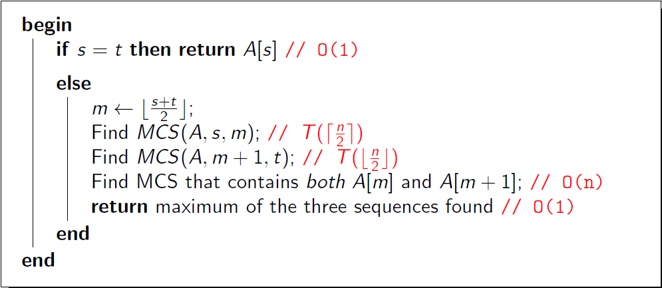
Analysis of the D&C Algorithm
n: problem size (n = t - s + 1)
T(n): time needed to run MCS(A, s, t)

Slide 96
Analysis of the D&C Algorithm
n: problem size (n = t - s + 1)
T(n): time needed to run MCS(A, s, t)

Slide 97
Analysis of the D&C Algorithm
n: problem size (n = t - s + 1)
T(n): time needed to run MCS(A, s, t)

Slide 98
Analysis of the D&C Algorithm
n: problem size (n = t - s + 1)
T(n): time needed to run MCS(A, s, t)

Slide 99
Analysis of the D&C Algorithm
n: problem size (n = t - s + 1)
T(n): time needed to run MCS(A, s, t)

Slide 100
Analysis of the D&C Algorithm
n: problem size (n = t - s + 1)
T(n): time needed to run MCS(A, s, t)

Slide 101

Analysis of the D&C Algorithm
n: problem size (n = t - s + 1)
T(n): time needed to run MCS(A, s, t)

Slide 102

Analysis of the D&C Algorithm
n: problem size (n = t - s + 1)
T(n): time needed to run MCS(A, s, t)

Slide 103
Analysis of the D&C Algorithm
n: problem size (n = t - s + 1)
T(n): time needed to run MCS(A, s, t)

Slide 104
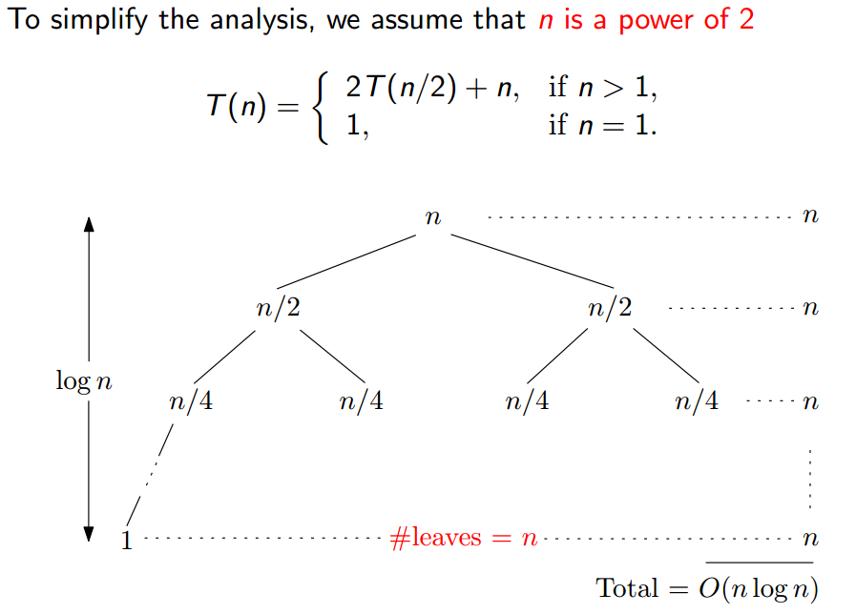
Analysis of the D&C Algorithm

Slide 105
Analysis of the D&C Algorithm

Slide 106
Summary
In the MCS problem, we saw 3 different algorithms for solving the maximum contiguous subarray problem
A O(n³) brute force algorithm

Slide 107
Summary
In the MCS problem, we saw 3 different algorithms for solving the maximum contiguous subarray problem
A O(n³) brute force algorithm
A O(n²) algorithm that reuses data

Slide 108
Summary
In the MCS problem, we saw 3 different algorithms for solving the maximum contiguous subarray problem
A O(n³) brute force algorithm
A O(n²) algorithm that reuses data
A O(n log n) divide-and-conquer algorithm

Slide 109
Summary
In the MCS problem, we saw 3 different algorithms for solving the maximum contiguous subarray problem
A O(n³) brute force algorithm
A O(n²) algorithm that reuses data
A O(n log n) divide-and-conquer algorithm
Can you solve the problem in O(n) time?

Slide 110
Outline
Introduction to Part I
Maximum Contiguous Subarray Problem
Problem definition
A brute force algorithm
A data-reuse algorithm
A divide-and-conquer algorithm
Analysis of the divide-and-conquer algorithm
Counting Inversions Problem
Problem definition
A brute force algorithm
A divide-and-conquer algorithm
Analysis of the divide-and-conquer algorithm

Slide 111
Counting inversions
Music site tries to match your song preferences with others.
You rank n songs.
Music site consults database to find people with similar tastes.

Slide 112
Counting inversions
Music site tries to match your song preferences with others.
You rank n songs.
Music site consults database to find people with similar tastes.
Similarity metric: number of inversions between two rankings.
 | A | B | C | D | E
Me | 1 | 2 | 3 | 4 | 5
You | 1 | 3 | 4 | 2 | 5

Slide 113
Counting inversions
Music site tries to match your song preferences with others.
You rank n songs.
Music site consults database to find people with similar tastes.
Similarity metric: number of inversions between two rankings.
My rank: 1, 2, …, n.
 | A | B | C | D | E
Me | 1 | 2 | 3 | 4 | 5
You | 1 | 3 | 4 | 2 | 5

Slide 114
Counting inversions
Music site tries to match your song preferences with others.
You rank n songs.
Music site consults database to find people with similar tastes.
Similarity metric: number of inversions between two rankings.
My rank: 1, 2, …, n.
Your rank: a₁, a₂, …, a_{n}.
 | A | B | C | D | E
Me | 1 | 2 | 3 | 4 | 5
You | 1 | 3 | 4 | 2 | 5

Slide 115
Counting inversions
Music site tries to match your song preferences with others.
You rank n songs.
Music site consults database to find people with similar tastes.
Similarity metric: number of inversions between two rankings.
My rank: 1, 2, …, n.
Your rank: a₁, a₂, …, a_{n}.
Songs i and j are inverted if i < j, but a_{i} > a_{j}
 | A | B | C | D | E
Me | 1 | 2 | 3 | 4 | 5
You | 1 | 3 | 4 | 2 | 5

Slide 116
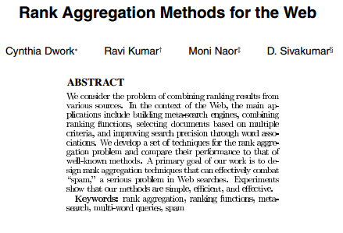
Counting inversions: applications
Voting theory.
Collaborative filtering.
Measuring the "sortedness" of an array.
Sensitivity analysis of Google's ranking function.
Rank aggregation for meta-searching on the Web.
Nonparametric statistics (e.g., Kendall's tau distance).

Slide 117
Outline
Introduction to Part I
Maximum Contiguous Subarray Problem
Problem definition
A brute force algorithm
A data-reuse algorithm
A divide-and-conquer algorithm
Analysis of the divide-and-conquer algorithm
Counting Inversions Problem
Problem definition
A brute force algorithm
A divide-and-conquer algorithm
Analysis of the divide-and-conquer algorithm

Slide 118
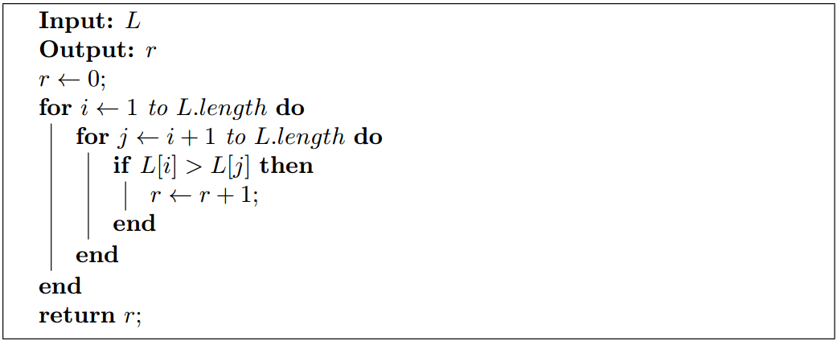
A Brute Force Algorithm
List each pair i < j and count the inversions.

Slide 119
A Brute Force Algorithm
List each pair i < j and count the inversions.

Slide 120
A Brute Force Algorithm
List each pair i < j and count the inversions.

Slide 121
A Brute Force Algorithm
List each pair i < j and count the inversions.

Slide 122
A Brute Force Algorithm
List each pair i < j and count the inversions.

Slide 123
A Brute Force Algorithm
List each pair i < j and count the inversions.

Slide 124

A Brute Force Algorithm
List each pair i < j and count the inversions.
$O(n^{2})$ comparisons and additions.

Slide 125
Outline
Introduction to Part I
Maximum Contiguous Subarray Problem
Problem definition
A brute force algorithm
A data-reuse algorithm
A divide-and-conquer algorithm
Analysis of the divide-and-conquer algorithm
Counting Inversions Problem
Problem definition
A brute force algorithm
A divide-and-conquer algorithm
Analysis of the divide-and-conquer algorithm

Slide 126
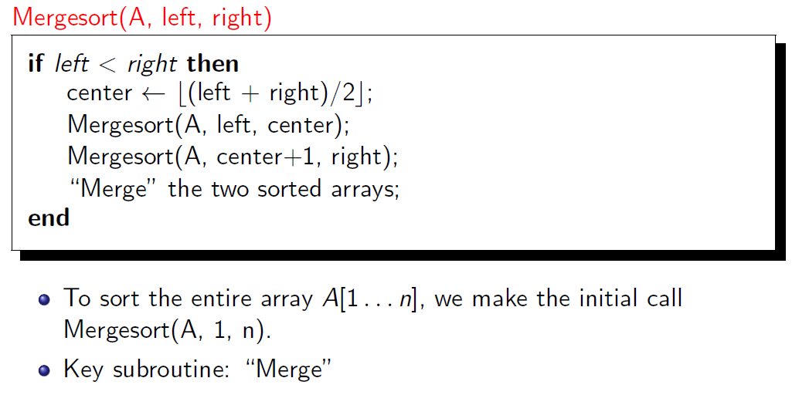
Review to Merge Sort

Slide 127
Counting inversions: divide-and-conquer
Input
14
7
18
3
10
19
11
23
2
25
16
17

Slide 128
Counting inversions: divide-and-conquer
Divide: separate list into two halves A and B.
Input
14
7
18
3
10
19
11
23
2
25
16
17

Slide 129
Counting inversions: divide-and-conquer
Divide: separate list into two halves A and B.
Input
14
7
18
3
10
19
11
23
2
25
16
17
14
7
18
3
10
19
11
23
2
25
16
17

Slide 130
Counting inversions: divide-and-conquer
Divide: separate list into two halves A and B.
Conquer: recursively count inversions in each list.
Input
14
7
18
3
10
19
11
23
2
25
16
17
14
7
18
3
10
19
11
23
2
25
16
17

Slide 131
Counting inversions: divide-and-conquer
Divide: separate list into two halves A and B.
Conquer: recursively count inversions in each list.
Input
14
7
18
3
10
19
11
23
2
25
16
17
14
7
18
3
10
19
11
23
2
25
16
17
Count inversions in left half A
14-7,14-3,14-10,7-3,18-3,18-10

Slide 132
Counting inversions: divide-and-conquer
Divide: separate list into two halves A and B.
Conquer: recursively count inversions in each list.
Input
14
7
18
3
10
19
11
23
2
25
16
17
14
7
18
3
10
19
11
23
2
25
16
17
Count inversions in left half A
Count inversions in right half B
14-7,14-3,14-10,7-3,18-3,18-10
11-2,23-2,23-16,23-17,25-16,25-17

Slide 133
Counting inversions: divide-and-conquer
Divide: separate list into two halves A and B.
Conquer: recursively count inversions in each list.
Combine: count inversions (a, b) with a∈A and b∈B.
Input
14
7
18
3
10
19
11
23
2
25
16
17
14
7
18
3
10
19
11
23
2
25
16
17
Count inversions in left half A
Count inversions in right half B
14-7,14-3,14-10,7-3,18-3,18-10
11-2,23-2,23-16,23-17,25-16,25-17

Slide 134
Counting inversions: divide-and-conquer
Divide: separate list into two halves A and B.
Conquer: recursively count inversions in each list.
Combine: count inversions (a, b) with a∈A and b∈B.
Input
14
7
18
3
10
19
11
23
2
25
16
17
14
7
18
3
10
19
11
23
2
25
16
17
Count inversions in left half A
Count inversions in right half B
14-7,14-3,14-10,7-3,18-3,18-10
11-2,23-2,23-16,23-17,25-16,25-17
Count inversions (a,b) with a∈A and b∈B
14-11,14-2,7-2,18-11,18-2,18-16,18-17,3-2,10-2,19-11,19-2,19-16,19-17

Slide 135
Counting inversions: divide-and-conquer
Divide: separate list into two halves A and B.
Conquer: recursively count inversions in each list.
Combine: count inversions (a, b) with a∈A and b∈B.
Return sum of three counts.
Input
14
7
18
3
10
19
11
23
2
25
16
17
14
7
18
3
10
19
11
23
2
25
16
17
Count inversions in left half A
Count inversions in right half B
14-7,14-3,14-10,7-3,18-3,18-10
11-2,23-2,23-16,23-17,25-16,25-17
Count inversions (a,b) with a∈A and b∈B
14-11,14-2,7-2,18-11,18-2,18-16,18-17,3-2,10-2,19-11,19-2,19-16,19-17

Slide 136
Counting inversions: divide-and-conquer
Divide: separate list into two halves A and B.
Conquer: recursively count inversions in each list.
Combine: count inversions (a, b) with a∈A and b∈B.
Return sum of three counts.
Input
14
7
18
3
10
19
11
23
2
25
16
17
14
7
18
3
10
19
11
23
2
25
16
17
Count inversions in left half A
Count inversions in right half B
14-7,14-3,14-10,7-3,18-3,18-10
11-2,23-2,23-16,23-17,25-16,25-17
Output
6+6+13 =25
Count inversions (a,b) with a∈A and b∈B
14-11,14-2,7-2,18-11,18-2,18-16,18-17,3-2,10-2,19-11,19-2,19-16,19-17

Slide 137
How to combine two subproblems?
Q. How to count inversions (a, b) with a ∈ A and b ∈ B?
List A
List B
14
7
18
3
10
19
11
23
2
25
16
17

Slide 138
Review to the Conquer Step of MCS Problem

Slide 139
How to combine two subproblems?
Q. How to count inversions (a, b) with a ∈ A and b ∈ B?
A. Easy if A and B are sorted!
Warmup algorithm.
List A
List B
14
7
18
3
10
19
11
23
2
25
16
17

Slide 140
How to combine two subproblems?
Q. How to count inversions (a, b) with a ∈ A and b ∈ B?
A. Easy if A and B are sorted!
Warmup algorithm.
Sort A and B.
List A
List B
14
7
18
3
10
19
11
23
2
25
16
17

Slide 141
How to combine two subproblems?
Q. How to count inversions (a, b) with a ∈ A and b ∈ B?
A. Easy if A and B are sorted!
Warmup algorithm.
Sort A and B.
Sort A
List B
3
7
10
14
18
19
11
23
2
25
16
17

Slide 142
How to combine two subproblems?
Q. How to count inversions (a, b) with a ∈ A and b ∈ B?
A. Easy if A and B are sorted!
Warmup algorithm.
Sort A and B.
Sort A
Sort B
3
7
10
14
18
19
2
11
16
17
23
25

Slide 143
How to combine two subproblems?
Q. How to count inversions (a, b) with a ∈ A and b ∈ B?
A. Easy if A and B are sorted!
Warmup algorithm.
Sort A and B.
For each element b ∈ B,
Sort A
Sort B
3
7
10
14
18
19
2
11
16
17
23
25

Slide 144
How to combine two subproblems?
Q. How to count inversions (a, b) with a ∈ A and b ∈ B?
A. Easy if A and B are sorted!
Warmup algorithm.
Sort A and B.
For each element b ∈ B,
binary search in A to find how many elements in A are greater than b.
Sort A
Sort B
3
7
10
14
18
19
2
11
16
17
23
25

Slide 145
How to combine two subproblems?
Q. How to count inversions (a, b) with a ∈ A and b ∈ B?
A. Easy if A and B are sorted!
Warmup algorithm.
Sort A and B.
For each element b ∈ B,
binary search in A to find how many elements in A are greater than b.
Sort A
Sort B
3
7
10
14
18
19
2
11
16
17
23
25
?
?
?
?
?
?
Count for b∈B

Slide 146
How to combine two subproblems?
Q. How to count inversions (a, b) with a ∈ A and b ∈ B?
A. Easy if A and B are sorted!
Warmup algorithm.
Sort A and B.
For each element b ∈ B,
binary search in A to find how many elements in A are greater than b.
Sort A
Sort B
3
7
10
14
18
19
2
11
16
17
23
25
6
?
?
?
?
?
Count for b∈B

Slide 147
How to combine two subproblems?
Q. How to count inversions (a, b) with a ∈ A and b ∈ B?
A. Easy if A and B are sorted!
Warmup algorithm.
Sort A and B.
For each element b ∈ B,
binary search in A to find how many elements in A are greater than b.
Sort A
Sort B
3
7
10
14
18
19
2
11
16
17
23
25
6
3
?
?
?
?
Count for b∈B

Slide 148
How to combine two subproblems?
Q. How to count inversions (a, b) with a ∈ A and b ∈ B?
A. Easy if A and B are sorted!
Warmup algorithm.
Sort A and B.
For each element b ∈ B,
binary search in A to find how many elements in A are greater than b.
Sort A
Sort B
3
7
10
14
18
19
2
11
16
17
23
25
6
3
2
?
?
?
Count for b∈B

Slide 149
How to combine two subproblems?
Q. How to count inversions (a, b) with a ∈ A and b ∈ B?
A. Easy if A and B are sorted!
Warmup algorithm.
Sort A and B.
For each element b ∈ B,
binary search in A to find how many elements in A are greater than b.
Sort A
Sort B
3
7
10
14
18
19
2
11
16
17
23
25
6
3
2
2
?
?
Count for b∈B

Slide 150
How to combine two subproblems?
Q. How to count inversions (a, b) with a ∈ A and b ∈ B?
A. Easy if A and B are sorted!
Warmup algorithm.
Sort A and B.
For each element b ∈ B,
binary search in A to find how many elements in A are greater than b.
Sort A
Sort B
3
7
10
14
18
19
2
11
16
17
23
25
6
3
2
2
0
?
Count for b∈B

Slide 151
How to combine two subproblems?
Q. How to count inversions (a, b) with a ∈ A and b ∈ B?
A. Easy if A and B are sorted!
Warmup algorithm.
Sort A and B.
For each element b ∈ B,
binary search in A to find how many elements in A are greater than b.
Sort A
Sort B
3
7
10
14
18
19
2
11
16
17
23
25
6
3
2
2
0
0
Count for b∈B

Slide 152
How to combine two subproblems?
Q. How to count inversions (a, b) with a ∈ A and b ∈ B?
A. Easy if A and B are sorted!
Warmup algorithm.
Sort A and B.
For each element b ∈ B,
binary search in A to find how many elements in A are greater than b.
Sort A
Sort B
3
7
10
14
18
19
2
11
16
17
23
25
Inversions between A and B:
6+3+2+2=13
6
3
2
2
0
0
Count for b∈B

Slide 153
Combine two subproblems: Improvement
Count inversions (a, b) with a ∈ A and b ∈ B, assuming A and B are sorted.

Slide 154
Combine two subproblems: Improvement
Count inversions (a, b) with a ∈ A and b ∈ B, assuming A and B are sorted.
Scan A and B from left to right.

Slide 155
Combine two subproblems: Improvement
Count inversions (a, b) with a ∈ A and b ∈ B, assuming A and B are sorted.
Scan A and B from left to right.
Compare a_{i} and b_{j}.
If a_{i} < b_{j}, then

Slide 156
Combine two subproblems: Improvement
Count inversions (a, b) with a ∈ A and b ∈ B, assuming A and B are sorted.
Scan A and B from left to right.
Compare a_{i} and b_{j}.
If a_{i} < b_{j}, then a_{i} is not inverted with any element left in B.
If a_{i} > b_{j}, then

Slide 157
Combine two subproblems: Improvement
Count inversions (a, b) with a ∈ A and b ∈ B, assuming A and B are sorted.
Scan A and B from left to right.
Compare a_{i} and b_{j}.
If a_{i} < b_{j}, then a_{i} is not inverted with any element left in B.
If a_{i} > b_{j}, then b_{j} is inverted with every element left in A.

Slide 158
Combine two subproblems: Improvement
Count inversions (a, b) with a ∈ A and b ∈ B, assuming A and B are sorted.
Scan A and B from left to right.
Compare a_{i} and b_{j}.
If a_{i} < b_{j}, then a_{i} is not inverted with any element left in B.
If a_{i} > b_{j}, then b_{j} is inverted with every element left in A.
Append smaller element to sorted list C.
3
7
10
14
18
19
2
11
16
17
23
25
Two sorted halves
Auxiliary array

Slide 159
Combine two subproblems: Improvement
Count inversions (a, b) with a ∈ A and b ∈ B, assuming A and B are sorted.
Scan A and B from left to right.
Compare a_{i} and b_{j}.
If a_{i} < b_{j}, then a_{i} is not inverted with any element left in B.
If a_{i} > b_{j}, then b_{j} is inverted with every element left in A.
Append smaller element to sorted list C.
i = 6
3
7
10
14
18
19
2
11
16
17
23
25
Two sorted halves
Auxiliary array
Total:

Slide 160
Combine two subproblems: Improvement
Count inversions (a, b) with a ∈ A and b ∈ B, assuming A and B are sorted.
Scan A and B from left to right.
Compare a_{i} and b_{j}.
If a_{i} < b_{j}, then a_{i} is not inverted with any element left in B.
If a_{i} > b_{j}, then b_{j} is inverted with every element left in A.
Append smaller element to sorted list C.
i = 6
3
7
10
14
18
19
2
11
16
17
23
25
Two sorted halves
6
2
Auxiliary array
Total: 6

Slide 161
Combine two subproblems: Improvement
Count inversions (a, b) with a ∈ A and b ∈ B, assuming A and B are sorted.
Scan A and B from left to right.
Compare a_{i} and b_{j}.
If a_{i} < b_{j}, then a_{i} is not inverted with any element left in B.
If a_{i} > b_{j}, then b_{j} is inverted with every element left in A.
Append smaller element to sorted list C.
i = 6
3
7
10
14
18
19
2
11
16
17
23
25
Two sorted halves
6
2
Auxiliary array
Total: 6

Slide 162
Combine two subproblems: Improvement
Count inversions (a, b) with a ∈ A and b ∈ B, assuming A and B are sorted.
Scan A and B from left to right.
Compare a_{i} and b_{j}.
If a_{i} < b_{j}, then a_{i} is not inverted with any element left in B.
If a_{i} > b_{j}, then b_{j} is inverted with every element left in A.
Append smaller element to sorted list C.
i = 6
3
7
10
14
18
19
2
11
16
17
23
25
Two sorted halves
6
2
3
Auxiliary array
Total: 6

Slide 163
Combine two subproblems: Improvement
Count inversions (a, b) with a ∈ A and b ∈ B, assuming A and B are sorted.
Scan A and B from left to right.
Compare a_{i} and b_{j}.
If a_{i} < b_{j}, then a_{i} is not inverted with any element left in B.
If a_{i} > b_{j}, then b_{j} is inverted with every element left in A.
Append smaller element to sorted list C.
i = 5
3
7
10
14
18
19
2
11
16
17
23
25
Two sorted halves
6
2
3
Auxiliary array
Total: 6

Slide 164
Combine two subproblems: Improvement
Count inversions (a, b) with a ∈ A and b ∈ B, assuming A and B are sorted.
Scan A and B from left to right.
Compare a_{i} and b_{j}.
If a_{i} < b_{j}, then a_{i} is not inverted with any element left in B.
If a_{i} > b_{j}, then b_{j} is inverted with every element left in A.
Append smaller element to sorted list C.
i = 5
3
7
10
14
18
19
2
11
16
17
23
25
Two sorted halves
6
2
3
7
Auxiliary array
Total: 6

Slide 165
Combine two subproblems: Improvement
Count inversions (a, b) with a ∈ A and b ∈ B, assuming A and B are sorted.
Scan A and B from left to right.
Compare a_{i} and b_{j}.
If a_{i} < b_{j}, then a_{i} is not inverted with any element left in B.
If a_{i} > b_{j}, then b_{j} is inverted with every element left in A.
Append smaller element to sorted list C.
i = 4
3
7
10
14
18
19
2
11
16
17
23
25
Two sorted halves
6
2
3
7
Auxiliary array
Total: 6

Slide 166
Combine two subproblems: Improvement
Count inversions (a, b) with a ∈ A and b ∈ B, assuming A and B are sorted.
Scan A and B from left to right.
Compare a_{i} and b_{j}.
If a_{i} < b_{j}, then a_{i} is not inverted with any element left in B.
If a_{i} > b_{j}, then b_{j} is inverted with every element left in A.
Append smaller element to sorted list C.
i = 4
3
7
10
14
18
19
2
11
16
17
23
25
Two sorted halves
6
2
3
7
10
Auxiliary array
Total: 6

Slide 167
Combine two subproblems: Improvement
Count inversions (a, b) with a ∈ A and b ∈ B, assuming A and B are sorted.
Scan A and B from left to right.
Compare a_{i} and b_{j}.
If a_{i} < b_{j}, then a_{i} is not inverted with any element left in B.
If a_{i} > b_{j}, then b_{j} is inverted with every element left in A.
Append smaller element to sorted list C.
i = 3
3
7
10
14
18
19
2
11
16
17
23
25
Two sorted halves
6
2
3
7
10
Auxiliary array
Total: 6

Slide 168
Combine two subproblems: Improvement
Count inversions (a, b) with a ∈ A and b ∈ B, assuming A and B are sorted.
Scan A and B from left to right.
Compare a_{i} and b_{j}.
If a_{i} < b_{j}, then a_{i} is not inverted with any element left in B.
If a_{i} > b_{j}, then b_{j} is inverted with every element left in A.
Append smaller element to sorted list C.
i = 3
3
7
10
14
18
19
2
11
16
17
23
25
Two sorted halves
6
3
2
3
7
10
11
Auxiliary array
Total: 6+3

Slide 169
Combine two subproblems: Improvement
Count inversions (a, b) with a ∈ A and b ∈ B, assuming A and B are sorted.
Scan A and B from left to right.
Compare a_{i} and b_{j}.
If a_{i} < b_{j}, then a_{i} is not inverted with any element left in B.
If a_{i} > b_{j}, then b_{j} is inverted with every element left in A.
Append smaller element to sorted list C.
i = 3
3
7
10
14
18
19
2
11
16
17
23
25
Two sorted halves
6
3
2
3
7
10
11
Auxiliary array
Total: 6+3

Slide 170
Combine two subproblems: Improvement
Count inversions (a, b) with a ∈ A and b ∈ B, assuming A and B are sorted.
Scan A and B from left to right.
Compare a_{i} and b_{j}.
If a_{i} < b_{j}, then a_{i} is not inverted with any element left in B.
If a_{i} > b_{j}, then b_{j} is inverted with every element left in A.
Append smaller element to sorted list C.
i = 3
3
7
10
14
18
19
2
11
16
17
23
25
Two sorted halves
6
3
2
3
7
10
11
14
Auxiliary array
Total: 6+3

Slide 171
Combine two subproblems: Improvement
Count inversions (a, b) with a ∈ A and b ∈ B, assuming A and B are sorted.
Scan A and B from left to right.
Compare a_{i} and b_{j}.
If a_{i} < b_{j}, then a_{i} is not inverted with any element left in B.
If a_{i} > b_{j}, then b_{j} is inverted with every element left in A.
Append smaller element to sorted list C.
i = 2
3
7
10
14
18
19
2
11
16
17
23
25
Two sorted halves
6
3
2
3
7
10
11
14
Auxiliary array
Total: 6+3

Slide 172
Combine two subproblems: Improvement
Count inversions (a, b) with a ∈ A and b ∈ B, assuming A and B are sorted.
Scan A and B from left to right.
Compare a_{i} and b_{j}.
If a_{i} < b_{j}, then a_{i} is not inverted with any element left in B.
If a_{i} > b_{j}, then b_{j} is inverted with every element left in A.
Append smaller element to sorted list C.
i = 2
3
7
10
14
18
19
2
11
16
17
23
25
Two sorted halves
6
3
2
2
3
7
10
11
14
16
Auxiliary array
Total: 6+3+2

Slide 173
Combine two subproblems: Improvement
Count inversions (a, b) with a ∈ A and b ∈ B, assuming A and B are sorted.
Scan A and B from left to right.
Compare a_{i} and b_{j}.
If a_{i} < b_{j}, then a_{i} is not inverted with any element left in B.
If a_{i} > b_{j}, then b_{j} is inverted with every element left in A.
Append smaller element to sorted list C.
i = 2
3
7
10
14
18
19
2
11
16
17
23
25
Two sorted halves
6
3
2
2
3
7
10
11
14
16
Auxiliary array
Total: 6+3+2

Slide 174
Combine two subproblems: Improvement
Count inversions (a, b) with a ∈ A and b ∈ B, assuming A and B are sorted.
Scan A and B from left to right.
Compare a_{i} and b_{j}.
If a_{i} < b_{j}, then a_{i} is not inverted with any element left in B.
If a_{i} > b_{j}, then b_{j} is inverted with every element left in A.
Append smaller element to sorted list C.
i = 2
3
7
10
14
18
19
2
11
16
17
23
25
Two sorted halves
6
3
2
2
2
3
7
10
11
14
16
17
Auxiliary array
Total: 6+3+2+2

Slide 175
Combine two subproblems: Improvement
Count inversions (a, b) with a ∈ A and b ∈ B, assuming A and B are sorted.
Scan A and B from left to right.
Compare a_{i} and b_{j}.
If a_{i} < b_{j}, then a_{i} is not inverted with any element left in B.
If a_{i} > b_{j}, then b_{j} is inverted with every element left in A.
Append smaller element to sorted list C.
i = 2
3
7
10
14
18
19
2
11
16
17
23
25
Two sorted halves
6
3
2
2
2
3
7
10
11
14
16
17
Auxiliary array
Total: 6+3+2+2

Slide 176
Combine two subproblems: Improvement
Count inversions (a, b) with a ∈ A and b ∈ B, assuming A and B are sorted.
Scan A and B from left to right.
Compare a_{i} and b_{j}.
If a_{i} < b_{j}, then a_{i} is not inverted with any element left in B.
If a_{i} > b_{j}, then b_{j} is inverted with every element left in A.
Append smaller element to sorted list C.
i = 2
3
7
10
14
18
19
2
11
16
17
23
25
Two sorted halves
6
3
2
2
2
3
7
10
11
14
16
17
18
Auxiliary array
Total: 6+3+2+2

Slide 177
Combine two subproblems: Improvement
Count inversions (a, b) with a ∈ A and b ∈ B, assuming A and B are sorted.
Scan A and B from left to right.
Compare a_{i} and b_{j}.
If a_{i} < b_{j}, then a_{i} is not inverted with any element left in B.
If a_{i} > b_{j}, then b_{j} is inverted with every element left in A.
Append smaller element to sorted list C.
i = 1
3
7
10
14
18
19
2
11
16
17
23
25
Two sorted halves
6
3
2
2
2
3
7
10
11
14
16
17
18
Auxiliary array
Total: 6+3+2+2

Slide 178
Combine two subproblems: Improvement
Count inversions (a, b) with a ∈ A and b ∈ B, assuming A and B are sorted.
Scan A and B from left to right.
Compare a_{i} and b_{j}.
If a_{i} < b_{j}, then a_{i} is not inverted with any element left in B.
If a_{i} > b_{j}, then b_{j} is inverted with every element left in A.
Append smaller element to sorted list C.
i = 1
3
7
10
14
18
19
2
11
16
17
23
25
Two sorted halves
6
3
2
2
2
3
7
10
11
14
16
17
18
19
Auxiliary array
Total: 6+3+2+2

Slide 179
Combine two subproblems: Improvement
Count inversions (a, b) with a ∈ A and b ∈ B, assuming A and B are sorted.
Scan A and B from left to right.
Compare a_{i} and b_{j}.
If a_{i} < b_{j}, then a_{i} is not inverted with any element left in B.
If a_{i} > b_{j}, then b_{j} is inverted with every element left in A.
Append smaller element to sorted list C.
First half exhausted
i = 0
3
7
10
14
18
19
2
11
16
17
23
25
Two sorted halves
6
3
2
2
2
3
7
10
11
14
16
17
18
19
Auxiliary array
Total: 6+3+2+2

Slide 180
Combine two subproblems: Improvement
Count inversions (a, b) with a ∈ A and b ∈ B, assuming A and B are sorted.
Scan A and B from left to right.
Compare a_{i} and b_{j}.
If a_{i} < b_{j}, then a_{i} is not inverted with any element left in B.
If a_{i} > b_{j}, then b_{j} is inverted with every element left in A.
Append smaller element to sorted list C.
i = 0
3
7
10
14
18
19
2
11
16
17
23
25
Two sorted halves
6
3
2
2
0
2
3
7
10
11
14
16
17
18
19
23
Auxiliary array
Total: 6+3+2+2+0

Slide 181
Combine two subproblems: Improvement
Count inversions (a, b) with a ∈ A and b ∈ B, assuming A and B are sorted.
Scan A and B from left to right.
Compare a_{i} and b_{j}.
If a_{i} < b_{j}, then a_{i} is not inverted with any element left in B.
If a_{i} > b_{j}, then b_{j} is inverted with every element left in A.
Append smaller element to sorted list C.
i = 0
3
7
10
14
18
19
2
11
16
17
23
25
Two sorted halves
6
3
2
2
0
2
3
7
10
11
14
16
17
18
19
23
25
Auxiliary array
Total: 6+3+2+2+0+0

Slide 182
Combine two subproblems: Improvement
Count inversions (a, b) with a ∈ A and b ∈ B, assuming A and B are sorted.
Scan A and B from left to right.
Compare a_{i} and b_{j}.
If a_{i} < b_{j}, then a_{i} is not inverted with any element left in B.
If a_{i} > b_{j}, then b_{j} is inverted with every element left in A.
Append smaller element to sorted list C.
i = 0
3
7
10
14
18
19
2
11
16
17
23
25
Two sorted halves
6
3
2
2
0
2
3
7
10
11
14
16
17
18
19
23
25
Auxiliary array
Total: 6+3+2+2+0+0 = 13

Slide 183

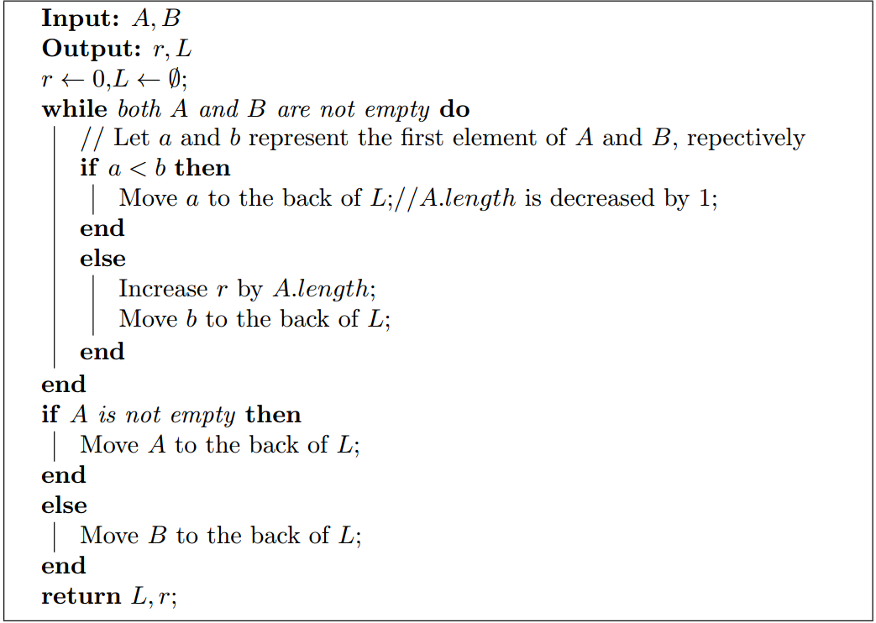
Combine two subproblems: Improvement

Slide 184
Combine two subproblems: Improvement

Slide 185
Combine two subproblems: Improvement

Slide 186
Combine two subproblems: Improvement

Slide 187
Combine two subproblems: Improvement

Slide 188
Combine two subproblems: Improvement

Slide 189
Combine two subproblems: Improvement

Slide 190
Combine two subproblems: Improvement

Slide 191
Combine two subproblems: Improvement

Slide 192
Combine two subproblems: Improvement
For every element in A and B,

Slide 193
Combine two subproblems: Improvement
For every element in A and B,
Only O( ) times operations are executed.

Slide 194
Combine two subproblems: Improvement
For every element in A and B,
Only O(1) times operations are executed.

Slide 195
Combine two subproblems: Improvement
For every element in A and B,
Only O(1) times operations are executed.
Function Sort-and-Count(A,B) can be executed in O( ) time where n is the number of elements in A and B.

Slide 196
Combine two subproblems: Improvement
For every element in A and B,
Only O(1) times operations are executed.
Function Sort-and-Count(A,B) can be executed in O(n) time where n is the number of elements in A and B.

Slide 197
The Complete Divide-and-Conquer Algorithm

Slide 198
Review of The Complete MCS Algorithm

Slide 199
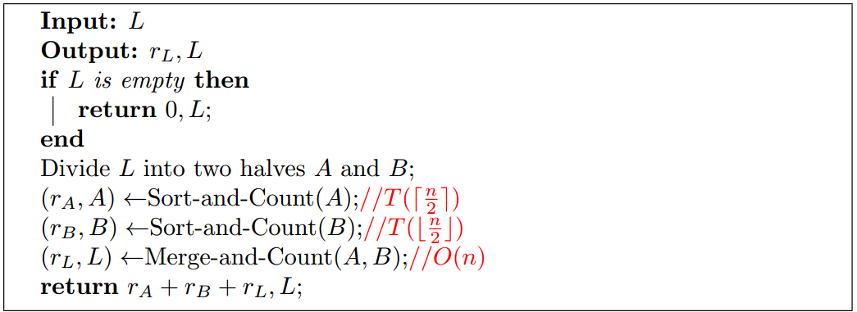
The Complete Divide-and-Conquer Algorithm

Slide 200
The Complete Divide-and-Conquer Algorithm

Slide 201
The Complete Divide-and-Conquer Algorithm

Slide 202
The Complete Divide-and-Conquer Algorithm

Slide 203
The Complete Divide-and-Conquer Algorithm

Slide 204
The Complete Divide-and-Conquer Algorithm

Slide 205
The Complete Divide-and-Conquer Algorithm
$$T(n)=\left\{\begin{aligned}O\left(1\right), if n=1 \\ &T\left(\left\lceil \frac{n}{2}\right\rceil \right)+T\left(\left\lfloor \frac{n}{2}\right\rfloor \right)+O(n) otherwise\end{aligned}\right.$$

Slide 206
Example
Divide
14
7
18
3
10
19
11
23
2
25
16
17
Auxiliary array

Slide 207
Example
Divide
14
7
18
3
10
19
11
23
2
25
16
17
Auxiliary array

Slide 208
Example
Divide
14
7
18
3
10
19
11
23
2
25
16
17
14
7
18
3
10
19
11
23
2
25
16
17
Auxiliary array

Slide 209
Example
Divide
14
7
18
3
10
19
11
23
2
25
16
17
14
7
18
3
10
19
11
23
2
25
16
17
Auxiliary array

Slide 210
Example
Divide
14
7
18
3
10
19
11
23
2
25
16
17
14
7
18
3
10
19
11
23
2
25
16
17
14
7
18
3
10
19
Auxiliary array

Slide 211
Example
Divide
14
7
18
3
10
19
11
23
2
25
16
17
14
7
18
3
10
19
11
23
2
25
16
17
14
7
18
3
10
19
11
23
2
25
16
17
Auxiliary array

Slide 212
Example
Divide
14
7
18
3
10
19
11
23
2
25
16
17
14
7
18
3
10
19
11
23
2
25
16
17
14
7
18
3
10
19
11
23
2
25
16
17

Slide 213
Example
Divide
14
7
18
3
10
19
11
23
2
25
16
17
14
7
18
3
10
19
11
23
2
25
16
17
14
7
18
3
10
19
11
23
2
25
16
17
14
7
3
10
Auxiliary array

Slide 214
Example
Divide
14
7
18
3
10
19
11
23
2
25
16
17
14
7
18
3
10
19
11
23
2
25
16
17
14
7
18
3
10
19
11
23
2
25
16
17
14
7
3
10
11
23
25
16

Slide 215
Example
Conquer
14
7
18
3
10
19
11
23
2
25
16
17

Slide 216
Example
Conquer
14
7
18
3
10
19
11
23
2
25
16
17
cnt=1
7
14

Slide 217
Example
Conquer
14
7
18
3
10
19
11
23
2
25
16
17
cnt=1
cnt=0
7
14
cnt=0

Slide 218
Example
Conquer
14
7
18
3
10
19
11
23
2
25
16
17
cnt=1
cnt=0
7
14
cnt=0
7
14
18
cnt=1

Slide 219
Example
Conquer
14
7
18
3
10
19
11
23
2
25
16
17
cnt=1
cnt=0
cnt=0
7
14
3
10
cnt=0
7
14
18
cnt=1

Slide 220
Example
Conquer
14
7
18
3
10
19
11
23
2
25
16
17
cnt=1
cnt=0
cnt=0
cnt=0
7
14
3
10
cnt=0
cnt=0
7
14
18
cnt=1

Slide 221
Example
Conquer
14
7
18
3
10
19
11
23
2
25
16
17
cnt=1
cnt=0
cnt=0
cnt=0
7
14
3
10
cnt=0
cnt=0
7
14
18
3
10
19
cnt=1
cnt=0

Slide 222
Example
Conquer
14
7
18
3
10
19
11
23
2
25
16
17
cnt=1
cnt=0
cnt=0
cnt=0
7
14
3
10
cnt=0
cnt=0
7
14
18
3
10
19
cnt=1
cnt=0
cnt=5

Slide 223
Example
Conquer
14
7
18
3
10
19
11
23
2
25
16
17
cnt=1
cnt=0
cnt=0
cnt=0
7
14
3
10
cnt=0
cnt=0
7
14
18
3
10
19
cnt=1
cnt=0
cnt=5
3
7
10
14
18
19
cnt=6

Slide 224
Example
Conquer
14
7
18
3
10
19
11
23
2
25
16
17
cnt=1
cnt=0
cnt=0
cnt=0
cnt=0
7
14
3
10
11
23
cnt=0
cnt=0
7
14
18
3
10
19
cnt=1
cnt=0
cnt=5
3
7
10
14
18
19
cnt=6

Slide 225
Example
Conquer
14
7
18
3
10
19
11
23
2
25
16
17
cnt=1
cnt=0
cnt=0
cnt=0
cnt=0
cnt=0
7
14
3
10
11
23
cnt=0
cnt=0
cnt=2
7
14
18
3
10
19
cnt=1
cnt=0
cnt=5
3
7
10
14
18
19
cnt=6

Slide 226
Example
Conquer
14
7
18
3
10
19
11
23
2
25
16
17
cnt=1
cnt=0
cnt=0
cnt=0
cnt=0
cnt=0
7
14
3
10
11
23
cnt=0
cnt=0
cnt=2
7
14
18
3
10
19
2
11
23
cnt=1
cnt=0
cnt=2
cnt=5
3
7
10
14
18
19
cnt=6

Slide 227
Example
Conquer
14
7
18
3
10
19
11
23
2
25
16
17
cnt=1
cnt=0
cnt=0
cnt=0
cnt=0
cnt=0
cnt=0
cnt=1
7
14
3
10
11
23
16
25
cnt=0
cnt=0
cnt=2
7
14
18
3
10
19
2
11
23
cnt=1
cnt=0
cnt=2
cnt=5
3
7
10
14
18
19
cnt=6

Slide 228
Example
Conquer
14
7
18
3
10
19
11
23
2
25
16
17
cnt=1
cnt=0
cnt=0
cnt=0
cnt=0
cnt=0
cnt=0
cnt=1
7
14
3
10
11
23
16
25
cnt=0
cnt=0
cnt=2
cnt=1
7
14
18
3
10
19
2
11
23
cnt=1
cnt=0
cnt=2
cnt=5
3
7
10
14
18
19
cnt=6

Slide 229
Example
Conquer
14
7
18
3
10
19
11
23
2
25
16
17
cnt=1
cnt=0
cnt=0
cnt=0
cnt=0
cnt=0
cnt=0
cnt=1
7
14
3
10
11
23
16
25
cnt=0
cnt=0
cnt=2
cnt=1
7
14
18
3
10
19
2
11
23
16
17
25
cnt=1
cnt=0
cnt=2
cnt=2
cnt=5
3
7
10
14
18
19
cnt=6

Slide 230
Example
Conquer
14
7
18
3
10
19
11
23
2
25
16
17
cnt=1
cnt=0
cnt=0
cnt=0
cnt=0
cnt=0
cnt=0
cnt=1
7
14
3
10
11
23
16
25
cnt=0
cnt=0
cnt=2
cnt=1
7
14
18
3
10
19
2
11
23
16
17
25
cnt=1
cnt=0
cnt=2
cnt=2
cnt=5
cnt=2
3
7
10
14
18
19
cnt=6

Slide 231
Example
Conquer
14
7
18
3
10
19
11
23
2
25
16
17
cnt=1
cnt=0
cnt=0
cnt=0
cnt=0
cnt=0
cnt=0
cnt=1
7
14
3
10
11
23
16
25
cnt=0
cnt=0
cnt=2
cnt=1
7
14
18
3
10
19
2
11
23
16
17
25
cnt=1
cnt=0
cnt=2
cnt=2
cnt=5
cnt=2
3
7
10
14
18
19
2
11
16
17
23
25
cnt=6
cnt=6

Slide 232
Example
Conquer
14
7
18
3
10
19
11
23
2
25
16
17
cnt=1
cnt=0
cnt=0
cnt=0
cnt=0
cnt=0
cnt=0
cnt=1
7
14
3
10
11
23
16
25
cnt=0
cnt=0
cnt=2
cnt=1
7
14
18
3
10
19
2
11
23
16
17
25
cnt=1
cnt=0
cnt=2
cnt=2
cnt=5
cnt=2
3
7
10
14
18
19
2
11
16
17
23
25
cnt=6
cnt=6
cnt=13

Slide 233
Example
Conquer
14
7
18
3
10
19
11
23
2
25
16
17
cnt=1
cnt=0
cnt=0
cnt=0
cnt=0
cnt=0
cnt=0
cnt=1
7
14
3
10
11
23
16
25
cnt=0
cnt=0
cnt=2
cnt=1
7
14
18
3
10
19
2
11
23
16
17
25
cnt=1
cnt=0
cnt=2
cnt=2
cnt=5
cnt=2
3
7
10
14
18
19
2
11
16
17
23
25
cnt=6
cnt=6
cnt=13
2
3
7
10
11
14
16
17
18
19
23
25
cnt=25

Slide 234
Outline
Review to Divide-and-Conquer Paradigm
Polynomial Multiplication Problem
Problem definition
A brute force algorithm
A first divide-and-conquer algorithm
An improved divide-and-conquer algorithm
Analysis of the divide-and-conquer algorithm
Counting Inversion Problem
Problem definition
A brute force algorithm
A divide-and-conquer algorithm
Analysis of the divide-and-conquer algorithm

Slide 235

Analysis of the D&C Algorithm
Proposition. The sort-and-count algorithm counts the number of inversions in a permutation of size n in $O(n log⁡n)$time.

Slide 236

Analysis of the D&C Algorithm
Proposition. The sort-and-count algorithm counts the number of inversions in a permutation of size n in $O(n log⁡n)$time.
Proof. The worst-case running time T(n) satisfies the recurrence:

Slide 237
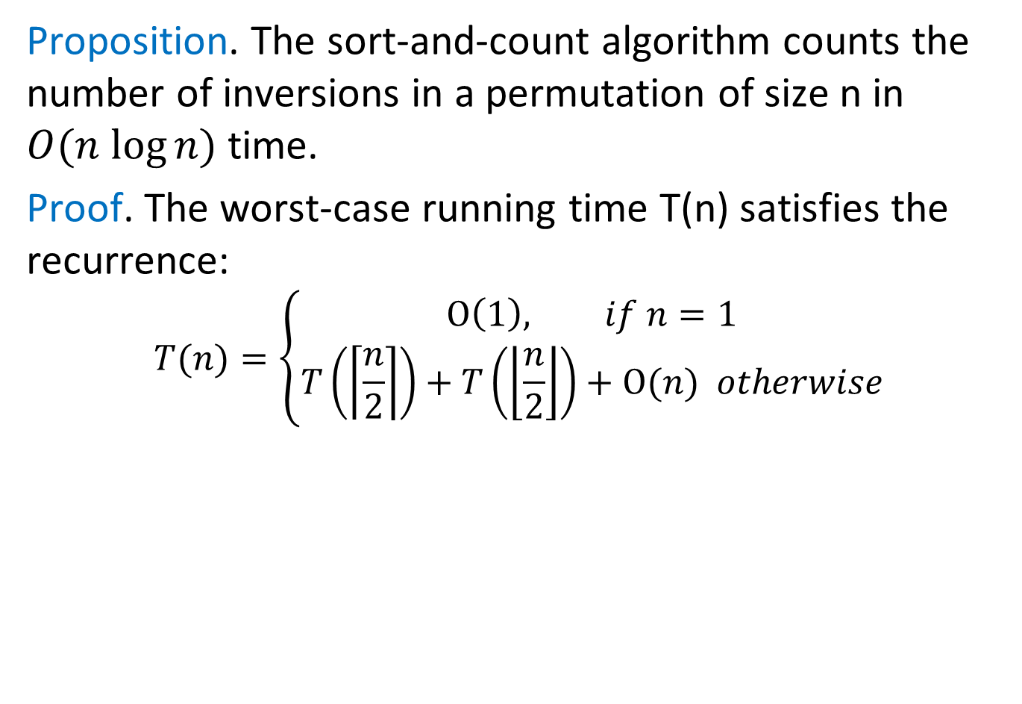
Analysis of the D&C Algorithm
Proposition. The sort-and-count algorithm counts the number of inversions in a permutation of size n in $O(n log⁡n)$ time.
Proof. The worst-case running time T(n) satisfies the recurrence:
$$T(n)=\left\{\begin{aligned}O\left(1\right), if n=1 \\ &T\left(\left\lceil \frac{n}{2}\right\rceil \right)+T\left(\left\lfloor \frac{n}{2}\right\rfloor \right)+O(n) otherwise\end{aligned}\right.$$

Slide 238


